Slide 1
Azure Fundamentals

Slide 2

Azure Fundamentals
Pablo Ariel Di Loreto
Guillermo Bellmann
Service Manager | Algeiba IT
Architect | Lagash
@PabloDiLoreto
@gjbellman
Día 4 – Sábado 11/08/2018

Slide 3
Check-In
¡Vamos arrancando!

Slide 4
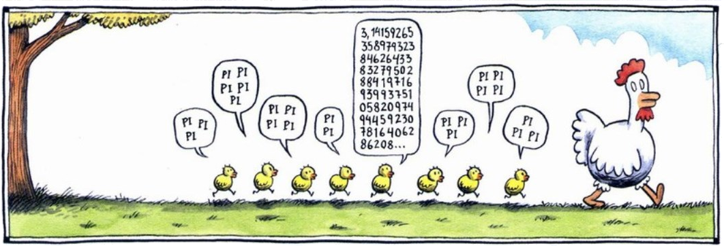
Expectativas

Slide 5
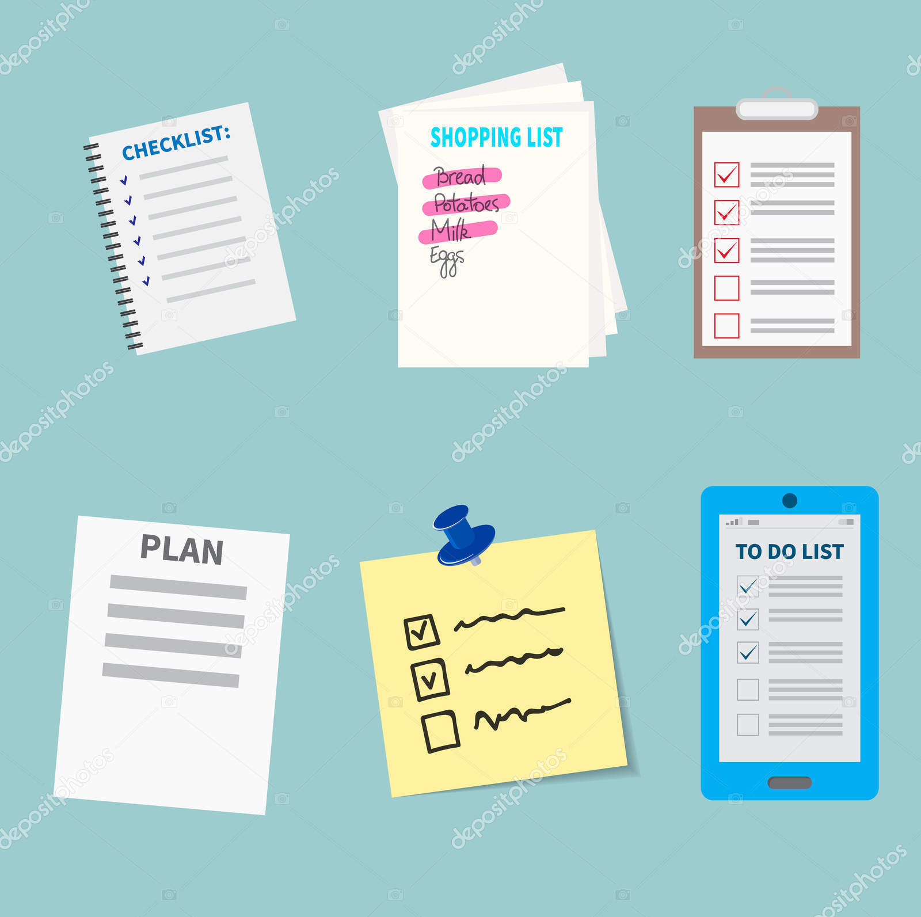
Sobre este Curso de Azure
Sábado 21/07/2018 de 09.30 AM a 01.30 PM:
  Tema 1: Nube Empresarial.
  Tema 2: La Nube como Centro de Cómputo.
Sábado 28/07/2018 de 09.30 AM a 01.30 PM:
  Tema 3: Plataforma de Datos.
  Tema 4: Big Data, Integración y Analítica.
Sábado 04/08/2018 de 09.30 AM a 01.30 PM:
  Tema 5: Redes.
  Tema 6: Resguardo y Recuperación.
Sábado 11/08/2018 de 09.30 AM a 01.30 PM:
  Tema 7: Monitoreo.
  Tema 7: Identidades en la Nube.

Slide 6
Metodología y Dinámica
Todo el material estará en Grupo Classroom (https://classroom.google.com) con el Class code rp2zez
Nivel del curso: 200 (escala 100 a 400). Web: http://www.mug-it.org.ar/event.aspx?event=441
Todos los temas a tratar tienen demos para reforzar los conceptos.
Los participantes podrán sacar una cuenta “Trial” de Azure en https://azure.microsoft.com/en-us/offers/ms-azr-0044p/
Al inicio de cada día habrá un “Quest” a responder.
El tiempo nos apremia: vamos a ir a ritmo moderado y constante.

Slide 7



Clasificación de Contenido
Contenido teórico
Ejercicio ó Más Info
Demo

Slide 8
Reglas Claras (conservan…)
Seamos puntuales para arrancar y finalizar.
Los celulares y otros dispositivos en silencio. Tu participación es lo más valioso y sin distracciones.
¿Preguntas? ¡Las que quieras! Pero sobre el tema que estamos viendo.
Evitemos opiniones personales de cualquier tipo, como también políticas y religiosas.

Slide 9
Canales de Comunicación
Google Classroom: https://classroom.google.com
Grupo de “Azure en Español” en Facebook: https://www.facebook.com/groups/AzureEnEspanol/
Grupo de Whats App (TecTimes): https://chat.whatsapp.com/KeEvR9719DR39BgNKn0NEc
Slack Net-Baires: https://slack.net-baires.com.ar/
Twitter: @PabloDiLoreto y @gjbellmann

Slide 10
Repaso de Día 3
Vamos a hacer un poco de memoria…

Slide 11
Día 4 | Tema 7: Identidades en la Nube

Slide 12



Desafíos de los Paradigmas de Seguridad
61% de los trabajadores mezclan tareas personales y trabajo en sus dispositivos*
>80% de los empleados admiten que usan aplicaciones no aprobadas de tipo SaaS en sus trabajos**
>70% de las intrusiones de red explotaron credenciales débiles o robadas ***
* Forrester Research: “BT Futures Report: Info workers will erase boundary between enterprise & consumer technologies,” Feb. 21, 2013
** http://www.computing.co.uk/ctg/news/2321750/more-than-80-per-cent-of-employees-use-non-approved-saas-apps-report
*** Verizon 2013 data breach investigation report

Slide 13
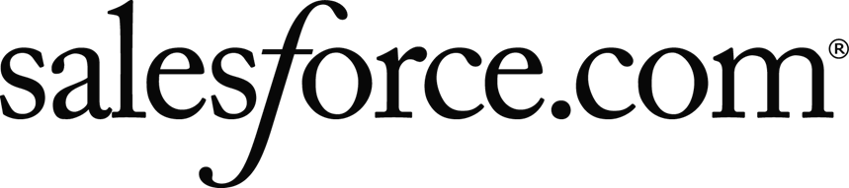


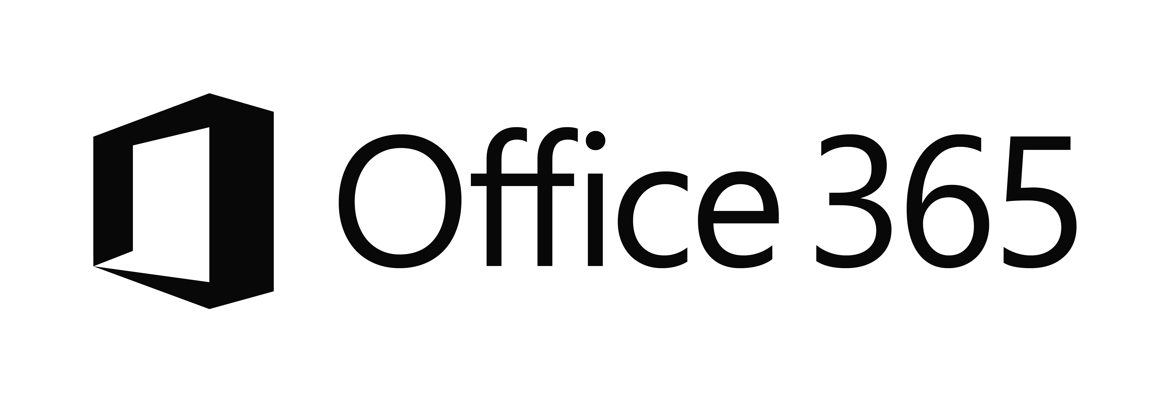

Desafíos de los Paradigmas de Seguridad
EC2
On-Premises
Managed devices
Private Cloud

Slide 14

Ouch…

Slide 15

Azure Active Directory: Servicio de Directorio en la Nube

Slide 16

Azure Active Directory
Es un servicio multi-tenant que provee gestión de identidad y acceso para la nube.
Facilita la escala global, disponibilidad y robustez.
Ofrece un SLA del 99.99% SLA (Azure AD Premium y Basic).
¿Qué puedo hacer con Azure AD?
  Gestionar usuarios y accesos a los recursos de la nube.
  Extender la infraestructura de LDAP a la nube.
  Provee single-sign-on (SSO) para aplicaciones de nube.
  Reduce el riesgo habilitando multi-factor auth.
  Soporta acceso programático.

Slide 17
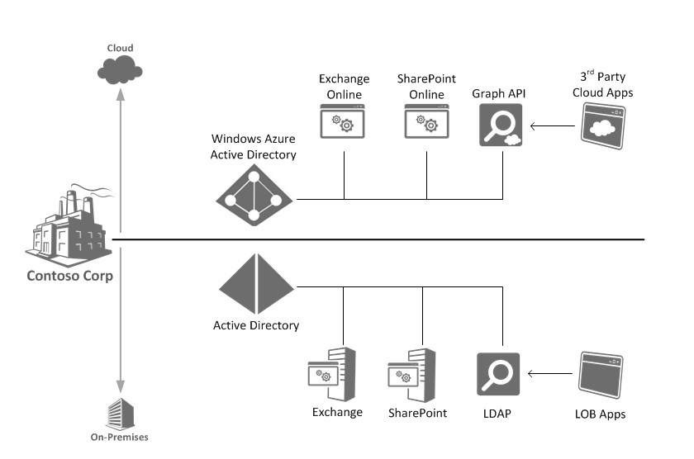
Azure AD & Windows Server AD

Slide 18


Azure Active Directory
Demo Time!

Slide 19
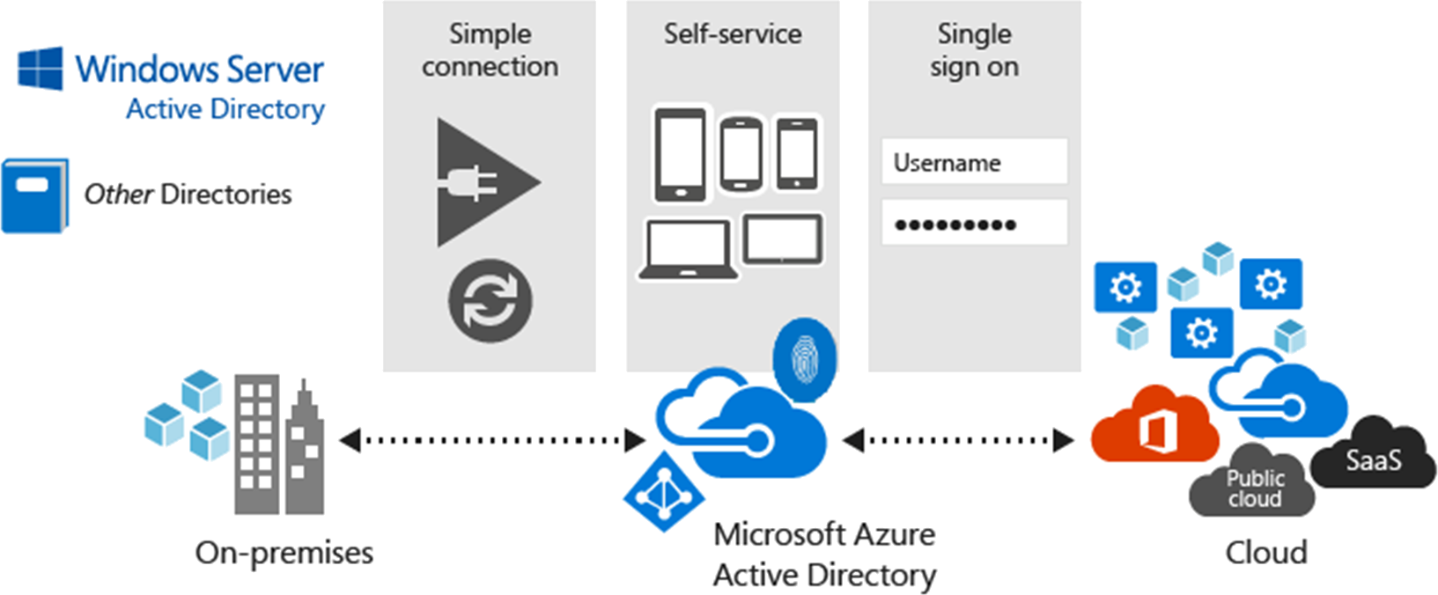
Azure Active Directory: Características

Slide 20
Azure Active Directory: Identidades… Identidades…

Slide 21
Características de Azure AD por SKU

Slide 22
Plataforma para Desarrolladores
Aplicaciones de Línea de Negocios (LoB) pueden integrarse con Azure AD.
Iniciar sesion a aplicaciones con identidades de nube.
Aplicaciones integrados con Azure AD pueden acceder a Ofice 365 y otras Web APIs.
Aplicaciones integrados pueden extender el esquema de Azure AD.
Soporte cross-platform (iOS, Android, and Windows)
Open Standards (SAML, OAuth 2.0, OpenID Connect, Odata 3.0).

Slide 23
Azure Active Directory: Tipo de Identidades

Slide 24
¿Tipos de Identidades?
Cloud Only
Sincronizada
Federada

Slide 25


Tipo de Identidades: Sincronizada vs Federada
Active Directory
Microsoft Azure
Identity Synchronization with password (hash) sync
User attributes are synchronized using Identity Synchronization services including a password hash, Authentication is completed against Azure Active Directory
Identity Synchronization
Microsoft Azure
User attributes are synchronized using Identity Synchronization tools, Authentication is passed back through federation and completed against Windows Server Active Directory
AD FS

Slide 26
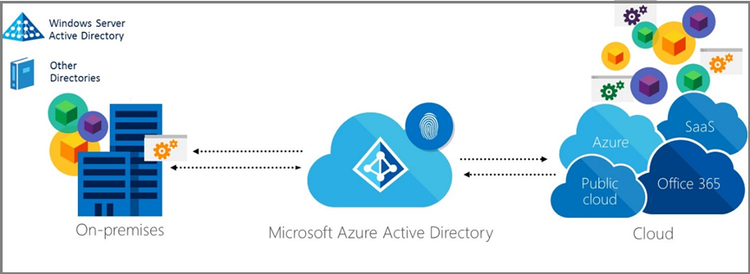
Azure Active Directory: Sincronización

Slide 27
Azure Active Directory: Sincronización

Slide 28
Azure AD Connect
Demo Time!

Slide 29
Azure Active Directory: Sincronización
Azure AD reemplaza herramientas anteriores:
  DirSync
  Azure AD Sync
  FIM and the Azure AD Connector
++ que tan solo una herramienta de sincronización:
  Gestiona las opciones de inicio de sesion de usuario.
  Write-back para passwords, devices y groups.
  Tools para soporte AD FS
    Simple UI experience to update AD FS SSL certificates
    Fix trust
    Login testing
Azure AD Connect Health agent.

Slide 30
Azure Active Directory Sync Do’s & Don’t’s
Do’s
Don´t
Do: Plan your Upgrade:
  In-place
  Parallel (staging) box
Do: Enable Azure AD Connect Health, ADFS Health, ADDS Health
Do: Sync what you need
Do: Use a “Consistency GUID”
if you are Multi-Forest
Don’t: Forget about Quota
  50K by default
  300K if you verify a domain
  Support ticket to raise it beyond
Don’t: Forget about Pass Through Auth & Seamless SSO
Don’t: Have to use ADFS
Don’t: Sync with DA/EA Account

Slide 31
Azure Active Directory: Autenticación y SSO

Slide 32
Opciones de Inicio de Sesión en Azure AD
The options defines how a synchronized on premises user signs in to Azure AD
  “Do not configure” is used if a 3rd party federated solution is being used
Seamless SSO works with PHS and PTA

Slide 33
Opciones de Inicio de Sesión en Azure AD

Slide 34
Azure AD Sign-in: Password Hash Synchronization

Slide 35
Azure AD Sign-in: Password Hash Synchronization

Slide 36
Azure AD Sign-in: Password Hash Synchronization facts
On-premises password complexity applies to synchronized users
  If an administrator changes the cloud password using PowerShell the Azure AD password policy applies
An locked out on-premises AD account can still be active in the cloud
  The cloud password for a PHS user is set to never expire
A disabled on-premises AD account will not be reflected in Azure AD until the next sync cycle
  Potentially 30 mins delay
PHS can be used in addition to federation and used as a fall-back

Slide 37
Azure AD Sign-in: Pass-thourgh autentication

Slide 38
Pass-through authentication
The pass-through authentication agent (AuthN agent) only requires outbound firewall ports
  Port 80 and 443
Multiple agents can be deployed for fault tolerance and performance
  Three agents should provide required performance
All communications via mutually authenticated HTTPS

Slide 39
Azure AD Sign-in: Pass-thourgh autentication setup

Slide 40
Azure AD Sign-in: Pass-thourgh authentication in action

Slide 41
Azure AD Sign-in: Federation with ADFS

Slide 42
Azure AD Sign-in: Federation with ADFS

Slide 43
Azure AD Sign-in: Federation with ADFS ¿a qué costo?

Slide 44
Azure AD Sign-in: Federation with ADFS ¿a qué costo?
Federation gives you
  SSO via on premises AD credentials
    Seamlessly authenticate to AD FS when the client is attached to the corporate network
    Now supported by Seamless SSO for PHS and PTA
  Passwords remain on-premises
    Now supported via PTA
  On-premises authentication policies
    Now supported via PTA
  On-premises authentication methods (multi-factor)
  Conditional access via AD FS
    Capabilities++ provided by Azure AD
Federation requires
  On-premises AD FS infrastructure with high-availability
  High-availability for the company’s Internet connection
    Remote workers will not be able to authenticate to Azure AD If the link is down
  Planned recovery from the loss of AD FS availability

Slide 45
Azure AD Sign-in: Federation with ADFS ¿a qué costo?
Federation may require manual certificate rollover
  Auto renewal possible for most configurations (AD FS auto certificate rollover enabled)
Federation doesn’t give you
  Cloud authentication scalability
  Identity Protection
    Requires P2 license
PHS & PTA
  Cloud authentication
  Cloud scalability
  Identity protect
PTA
  Simple deployment of agents
  Automatic update of on-premises agents
  Automatic rollover of certificates
  Requires high-availability for the company’s Internet connection

Slide 46
Compartiva de Opciones de Inicio de Sesión en Azure AD

Slide 47
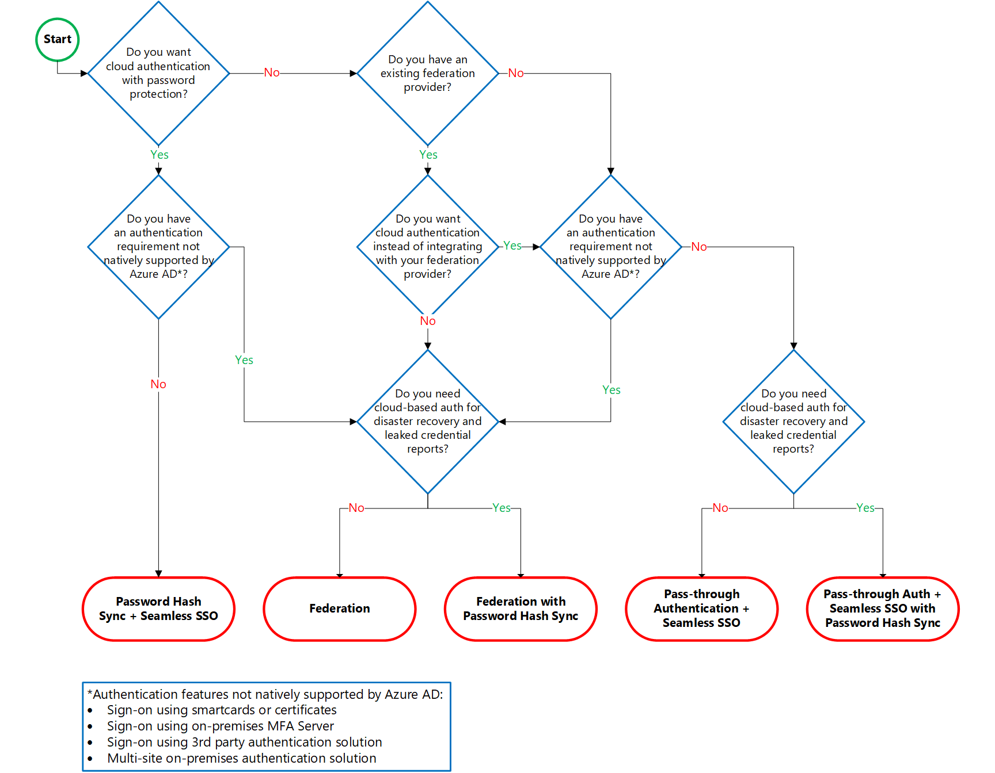
Compartiva de Opciones de Inicio de Sesión en Azure AD

Slide 48
Extendiendo Capacidades de Active Directory hacia la Nube

Slide 49
Capacidades de Autenticación Extendidas

Slide 50
Capacidades de Autenticación Extendidas
Authentication to applications via
  OpenID Connect / Oauth 2.0
  WS-Federation and SAML
  Windows Kerberos Authentication via the Azure AD Application Proxy
Self-service for
  Password resets, application and group management
MFA
Conditional access
Identity protection
Azure AD Join + MDM

Slide 51
Self-Service Password Reset
Demo Time!

Slide 52
Multi-Factor Authentication
A stand-alone Azure Identity and Access management service also included in Azure Active Directory Premium.
Prevents unauthorized access to both on-premises and cloud applications by providing an additional level of authentication.
Trusted by thousands of enterprises to authenticate employee, customer, and partner access.

Slide 53
Multi-Factor Authentication

Slide 54
Multi-Factor Authentication
Demo Time!

Slide 55
Azure MFA vs MFA for Office 365

Slide 56
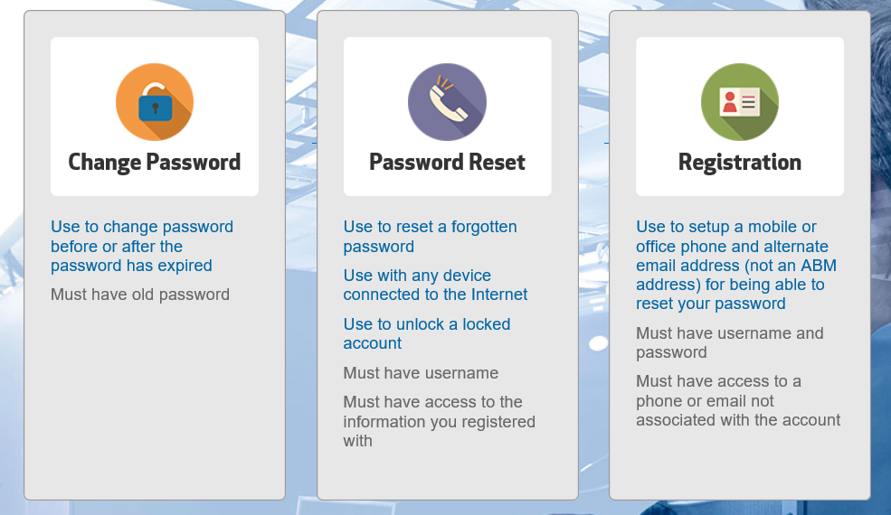
Password Reset Do’s & Don’t’s
Do’s
Don´t
Do: Your pre and post data homework
Do: Get executive sponsorship
Do: Stage using “Restrict Access to Password Reset”
Do: Use “Require Users To Register When Signing In”
Do: Deploy alongside an app that users want to use
Do: Communicate to end users
Do: consider building an SSPR Portal (password.company.com).
Do: Use the PowerBI Content Pack
Don’t: test with an Administrative Account

Slide 57
Azure AD Identity Protection
Demo Time!

Slide 58
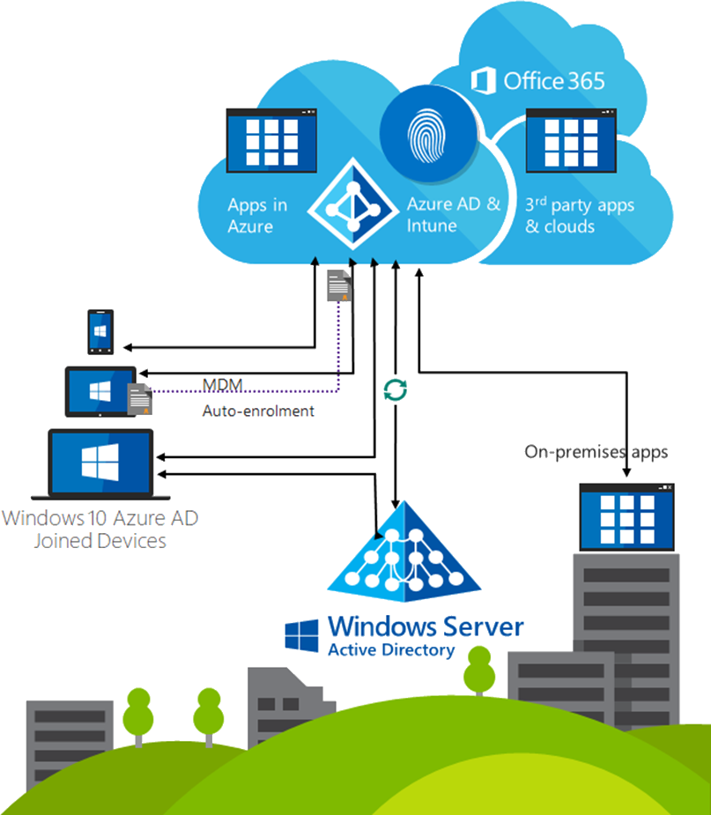
Azure AD Join
Azure AD Join makes it possible to connect work-owned Windows 10 devices to your company’s Azure Active Directory.
Users can sign into Windows with their cloud-hosted work credentials and enjoy modern Windows experiences.
Enterprise-compliant services
SSO from the desktop to cloud and on-premises applications with no VPN
MDM auto enrollment
Support for hybrid environments

Slide 59
Azure AD Join
Demo Time!

Slide 60
Extendiendo Capacidades de tus Aplicaciones

Slide 61
Publicación de Aplicaciones
Demo Time!

Slide 62
Web Application Proxy
A connector that auto connects to the cloud service
Multiple connectors can be deployed for redundancy, scale, multiple sites and different resources
Connectors are deployed usually on corpnet next to resources
Users connect to the cloud service that routs their traffic to the resources via the connectors

Slide 63
Web Application Proxy
Demo Time!

Slide 64
Conditional Access
Goals it can help you achieve:
  Prevent access to data from locations/clients that are undesirable
  Prevent data download to devices that you are not comfortable with
  Help you manage and reduce user and sign in risk
  Reduce user friction, too many MFA prompts teach the user the wrong thing

Slide 65
Conditional Access
It’s a part of your companies data loss prevention strategy
  Intune to manage the device or the Apps
  Azure information protection to Encrypt the data on the devices
  Windows 10 with Windows HELLO for Business ultimately for strong auth across the board (BRK2076)

Slide 66
Conditional Access

Slide 67
Conditional Access
Demo Time!

Slide 68
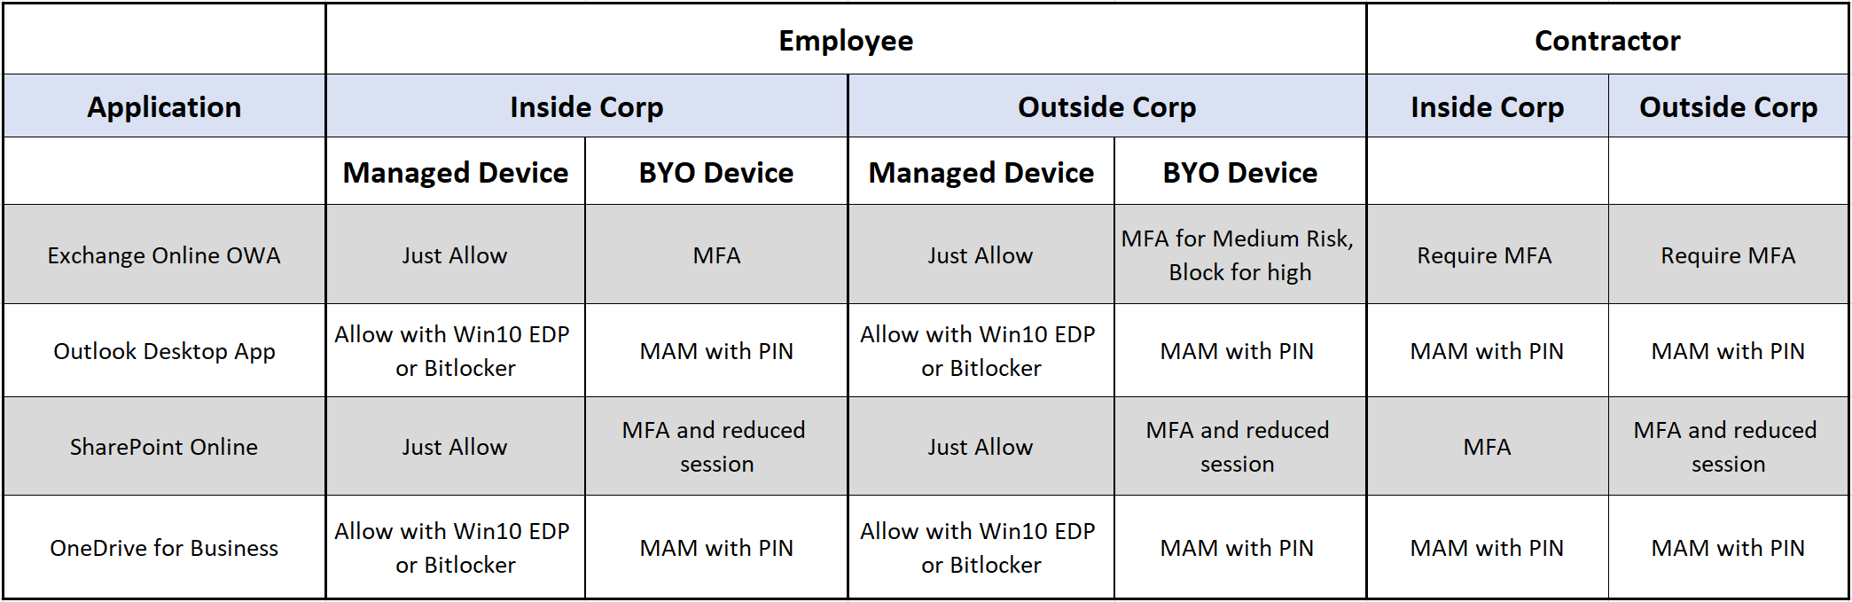
Conditional Access Matrix

Slide 69
Día 4 | Tema 8: Monitoreo de Apps

Slide 70
Overview de Monitoreo en Azure
  Application Insights
Application
End user
Real user monitoring
Usage, Page load, perf, errors…
Workload
Custom app
Application monitoring
Availability, failures, perf…
  Service Map
  Log Analytics
  Network Monitoring
  Container Monitoring
Infrastructure
Container
Compute, OS and infra monitoring
CPU, memory, storage, network, I/O…
Virtual Machine
Platform
  Azure Monitor
  Azure Advisor
  Azure Health
  Azure Security Center
Clouds OS
Azure resource monitoring
Network, storage, host OS…

Slide 71
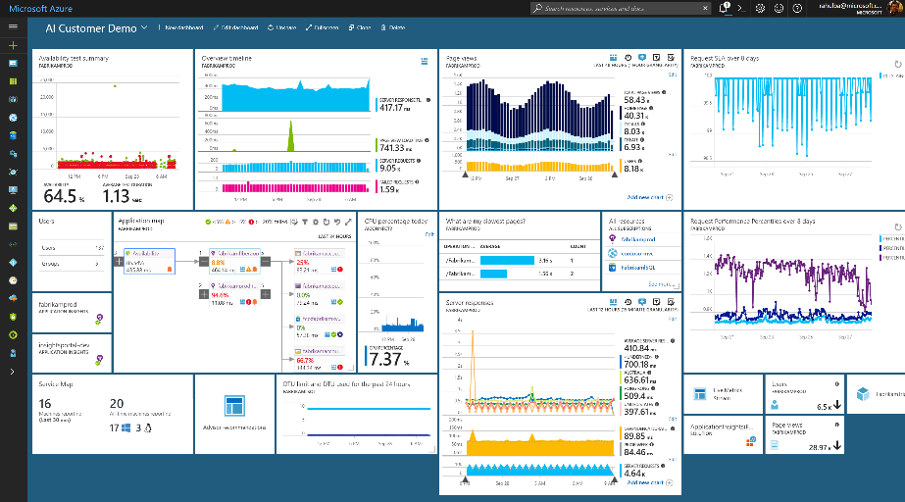
Application Insights
Health Check
Monitor & Optimize
Detect & Debug
ML/Data Analytics
Generate Alerts
Take Actions
Customer Insights
Export & Correlate

Slide 72



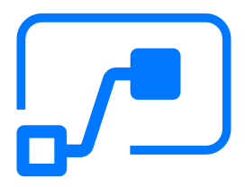





Application Insights Ecosystem
Ingestion
Exploration
Export & Correlation
Application Insights
Microsoft Azure Portal
OMS Connector
Power BI
Open Source SDKs
Status Monitor
Azure Extensions
Azure Monitor
Application Map
Live Metrics Stream
Profiler & Debugger
Microsoft Flow
Blob storage
Stream Analytics
SCOM MP Mobile Center Open Schema
Analytics Portal
Visual Studio Team Services
Visual Studio IDE
Data Access REST APIs
Support
ASP.NET
ASP.NET Core NEW!
Java - J2EE
Windows Desktop
WCF
JavaScript
Node.JS
PHP
Python
Ruby
Angular
Docker
Kubernetes NEW!
Dynamics CRM
Azure Web Apps
Azure Cloud Services
Azure VMs
Azure Functions NEW!
Azure Service Fabric NEW!
Glimpse
Spring
Log4Net/NLog
Log4J/Logback
System.Diagnostics
Semantic Logging (SLAB)
ETW/EventSource NEW!
LogStash
Collectd
Concrete
Drupal
Joomla
SharePoint
WordPress
Orchard
OSS/Public Endpoints
…

Slide 73
Application Insights Ecosystem
Health Check
  Azure Metrics & Dashboards NEW!
  Synthetic Monitoring
  Live Metrics Stream
  Smart Detection
Diagnostics & Optimizations
  Application Map
  Performance Monitoring & Profiling NEW!
  Failure Diagnostics & Snapshot Debugging NEW!
  CodeLens Integration
Ad-Hoc Analytics
  Application Insights Analytics Queries NEW!
  Smart Analytics with Machine Learning
Take Actions
  Alerts - Emails, Webhooks & Azure Mobile App NEW!
  Azure Monitor Auto-scaling
  Microsoft Flow & Logic Apps
Customer Insights
  User/Session/Event Monitoring
  Cohorts & Funnels NEW!
  Customer Retention
  User Flows NEW!
  Workbooks
Getting Started
  Visual Studio
  Status Monitor
  Azure Extensions

Slide 74
Application Insights
Demo Time!

Slide 75
Azure Certification
¿qué rendir?

Slide 76
Azure | Roadmap de Certificación

Slide 77
Check-Out
¿Qué nos llevamos hoy?

Slide 78

Resumen del día
Repasamos los temas vistos en el Día 3.
Presentamos Azure Active Directory:
  Servicio de Directorio.
  Tipo de Identidades
  Azure AD Connect.
  Autenticación con Azure AD.
Presentamos Extensiones de AD en la nube:
  Self-Service Password Reset
  Multi-Factor Authentication
  Conditional Access
  Azure AD Identity Protection
  Azure AD Join

Slide 79
Resumen del día
Presentamos Aplicaciones con Azure AD en la nube:
  Enterprise Applications
  Web App Proxy
  Conditional Access
Presentamos Monitoreo con Azure:
  Resumen de Prestaciones.
  Applications Insights.
Presentamos Roadmap de Examenes para Azure.

Slide 80
Sobre este Curso de Azure
Sábado 21/07/2018 de 09.30 AM a 01.30 PM:
  Tema 1: Nube Empresarial.
  Tema 2: La Nube como Centro de Cómputo.
Sábado 28/07/2018 de 09.30 AM a 01.30 PM:
  Tema 3: Plataforma de Datos.
  Tema 4: Big Data, Integración y Analítica.
Sábado 04/08/2018 de 09.30 AM a 01.30 PM:
  Tema 5: Redes.
  Tema 6: Resguardo y Recuperación.
Sábado 11/08/2018 de 09.30 AM a 01.30 PM:
  Tema 7: Monitoreo.
  Tema 8: Identidades en la Nube.

Slide 81
Feedback Time!
¿Completarías esta encuesta de 5 minutos?
https://es.surveymonkey.com/r/mugazure0718

Slide 82


Slide 83
Azure Fundamentals
Pablo Ariel Di Loreto
Guillermo Bellmann
Service Manager | Algeiba IT
Architect | Lagash
@PabloDiLoreto
@gjbellman
Día 4 – Sábado 11/08/2018

